Slide 1
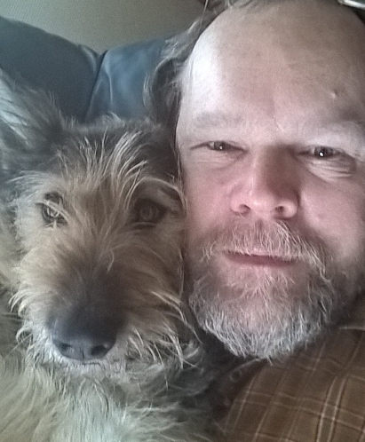
Climate Change in the Nordic Region – post-COP 21
Esko Kivisaari, 16.6.2016
12th AIDA Climate Change Working Party Meeting

Slide 2
Insurance is about pooling of risks: a good way to protect oneself from financial losses
”An agreement in which a person makes regular payments to a company and the company promises to pay money if the person is injured or dies, or to pay money equal to the value of something (such as a house or car) if it is damaged, lost, or stolen” (Merriam-Webster)

Slide 3
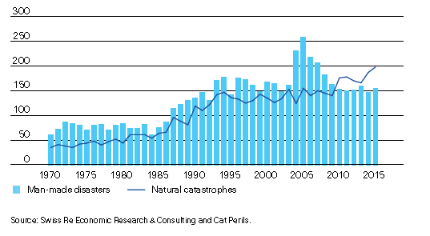
Evolution of the number of catastrophes

Slide 4
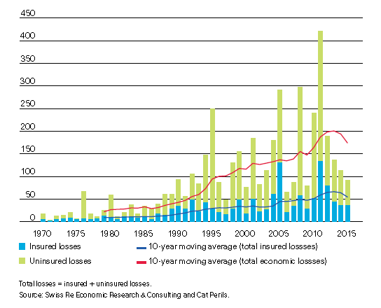
Insured and uninsured catastrophes

Slide 5
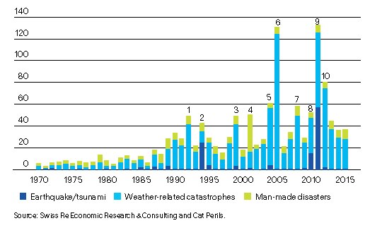
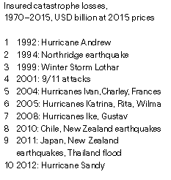
Insured catastrophe losses

Slide 6
Mitigation getting more important in the financial sector agenda
Mark Carney, Governor of the Bank of England, chair of the FSB (Financial Stability Board):
Breaking the Tragedy of the Horizon – climate change and financial stability (speech/Lloyd’s of London, 29.9.2015)
The Sustainable Goal Imperative (speech/UN General Assembly 21.4.2016)

Slide 7
From weather to climate
Weather: ”The state of the air and atmosphere at a particular time and place : the temperature and other outside conditions (such as rain, cloudiness, etc.) at a particular time and place” (Merriam-Webster)
Climate: ”The average course or condition of the weather at a place usually over a period of years as exhibited by temperature, wind velocity, and precipitation” (Merriam-Webster)

Slide 8
Climate in Finland until 2040
Temperature
winter temperatures in particular will rise
very low temperatures seem to become rarer
heat wave periods will probably become more common
the most extreme temperatures will probably rise
the growing season will become longer and warmer
Precipitation
particularly in the winter half of the year, precipitation will increase and it will be in liquid form more often
torrential rains are assumed to become more intense than average rainfall
the longest dry periods in winter and spring will become somewhat shorter
in summer, periods of dry weather may even become slightly longer

Slide 9
Climate in Finland until 2040 - continued
Wind speed
no significant changes are projected for Finland's wind climate in spring and summer
in autumn and winter, slightly stronger winds are expected to blow than at present
even though the changes are minor, they are similar in most models
Snow cover and soil frost
the snow cover period will become shorter
the water equivalent of snow and snow depth will decrease
soil frost will be less than at present
during mild, rainy winters, the ground will often be wet and its carrying capacity reduced

Slide 10
Climate in Finland until 2040 - continued
Cloud cover and sunshine
winters become darker
cloud cover is likely to remain largely unchanged in summer
The Baltic Sea will change
Water level may begin to rise in the Gulf of Finland and in the Gulf of Bothnia, the sea will recede slower than before
Ice cover will reduce in the Baltic Sea

Slide 11
STATEMENT FROM THE NORDIC INSURANCE INDUSTRY (2009)
Climate change is a threat to a stable and sustainable society and presents major challenges to our industry.
We take on the responsibility of compensating policyholders and providing them with
tools that help to manage and mitigate risks arising from climate change. As insurers
and major institutional investors we seek to encourage mitigation and adaptation efforts
and as a responsible industry we are dedicated to reducing our industry’s impact
on the environment.
Climate change creates uncertainty for our industry. There are therefore good reasons
for our industry to participate in climate work and make our contribution to a continued
stable and sustainable society. That is also something that the public rightly expects
us to do.
The Nordic insurance companies are in a good position to carry out active climate work
in a wide range of areas since insurance is involved in all parts of society. We offer a
large number of different insurance products and we insure almost all Nordic citizens
and businesses.

Slide 12
STATEMENT FROM THE NORDIC INSURANCE INDUSTRY (2009) - continued
Climate change is one of the biggest challenges of our time. The Nordic insurance industry will actively meet this challenge by
• developing and offering climatically sustainable products within life and non-life insurance;
• incorporating climate aspects into investment strategy considerations;
• using climatically sustainable methods in loss prevention and claims settlement;
• following up systematically on climatically sustainable activities implemented in the industry; and
• striving for climate smart ways of organizing and conducting our business.
The Nordic insurance companies cooperate on climate matters through their trade associations. This statement is one way of showing how the Nordic insurance industry meets the challenge of climate change.

Slide 13
Why climate risks are so difficult?
They exceed the strategic business planning time horizon,
They exceed the time horizon of politicians, and
They exceed the time horizon of authorities and central banks.

Slide 14
Climate risks are more than catastrophes
Physical risks are other issues in addition to catastrophes: risks in general increase with more precipitation etc.
Liability risks like those experienced with asbestosis –can e.g. energy producers be sued if they neglect today consequences of CO₂ emissions?
Transition from carbon dependence to renewables can lead to even abrupt changes in asset valuations

Slide 15
Insuring climate risks?
Demand expected for new risks – do we have the expertise to insure them?
Will risks change in such a way that even existing cover will result into unexpected claims?
Extremal weather events will become more frequent – can our models cope with this?

Slide 16
Moving to a low-carbon future
It is estimated that (UNCTAD World Investment Report, 2014) different investments connected to SDG (Sustainable Development Goals) for infrastructure, clean energy, water, sanitation, agriculture etc. require annually USD 5 to 7 billion.
These investments are not necessarily ”new” investments – instead they mean reductions in other investments.

Slide 17
FSB task force established in connection to COP21 – chaired by Michael Bloomberg
The aim is to develop:
consistent,
comparable,
reliable, and
clear
disclosures around climate-related financial risks.

Slide 18
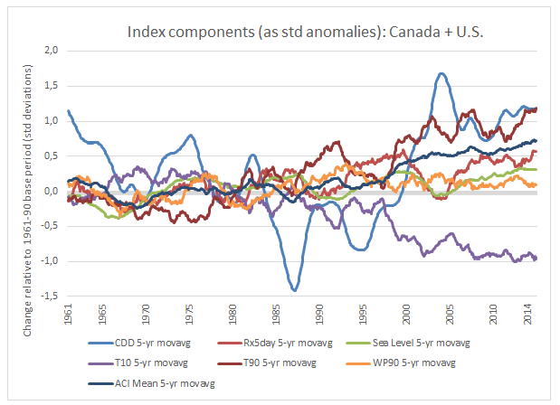
Actuarial Climate Index
1. Frequency of temperatures above the 90th percentile (warmer days and nights);
2. Frequency of temperatures below the 10th percentile (cooler days and nights);
3. Maximum five-day rainfall in the month (amount of rainfall);
4. Consecutive dry days (lack of rainfall);
5. Frequency of wind power, above the 90th percentile—wind power is equal to wind speed cubed, as damage has been found to be proportional to wind power; and
6. Sea level.

Slide 19
Challenges specific to insurance?
Correlation or causality?
Climate risks in a region heavily correlated
Adverse selection
Moral hazard
Maybe even on societal level when prevention is neglected when insurers cover the losses?

Slide 20
COP15 might be ambitious in limiting to 2 degrees,
But do you still remember acid rain?
Or ozone depletion?
We have challenges but they are there to be overcome!

